Slide 1
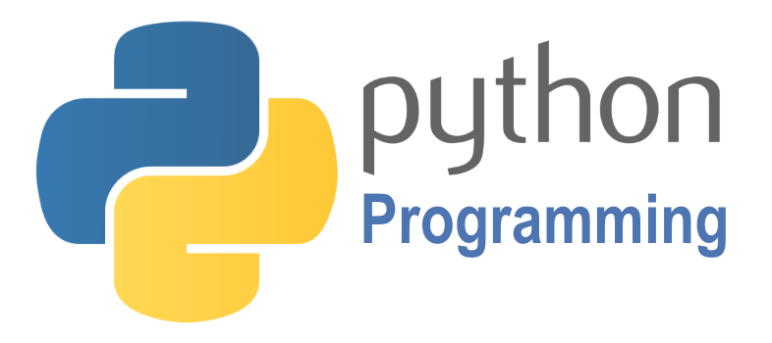

SCRIPTING
Course BIT07
Paco Hulpiau

Slide 2
Functions and modules

Slide 3
Introduction
Python programming paradigms:
Procedural programming (PP) → top-down approach, code written as a list of instructions to tell computer what to do step by step, relies on procedures or routines
Functional programming (FP) → passing data from function to function to get result, functions are treated as data and used as parameters and return them e.g.
Object-oriented programming (OOP) → encapsulating data and behavior into objects consisting of classes and methods

Slide 4
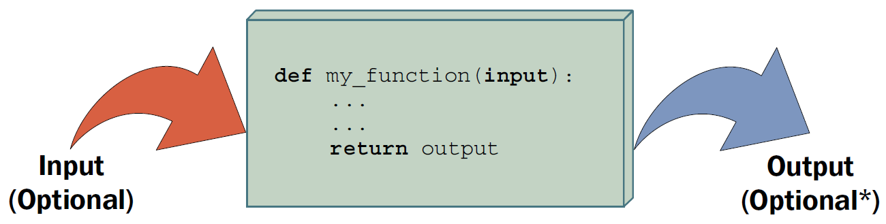
Introduction
A function groups a set of statements so they can be run more than once → packaged procedure invoked by name e.g. my_function → can compute a result value to return and let us specify input parameters → alternative to cutting and pasting code!

Slide 5
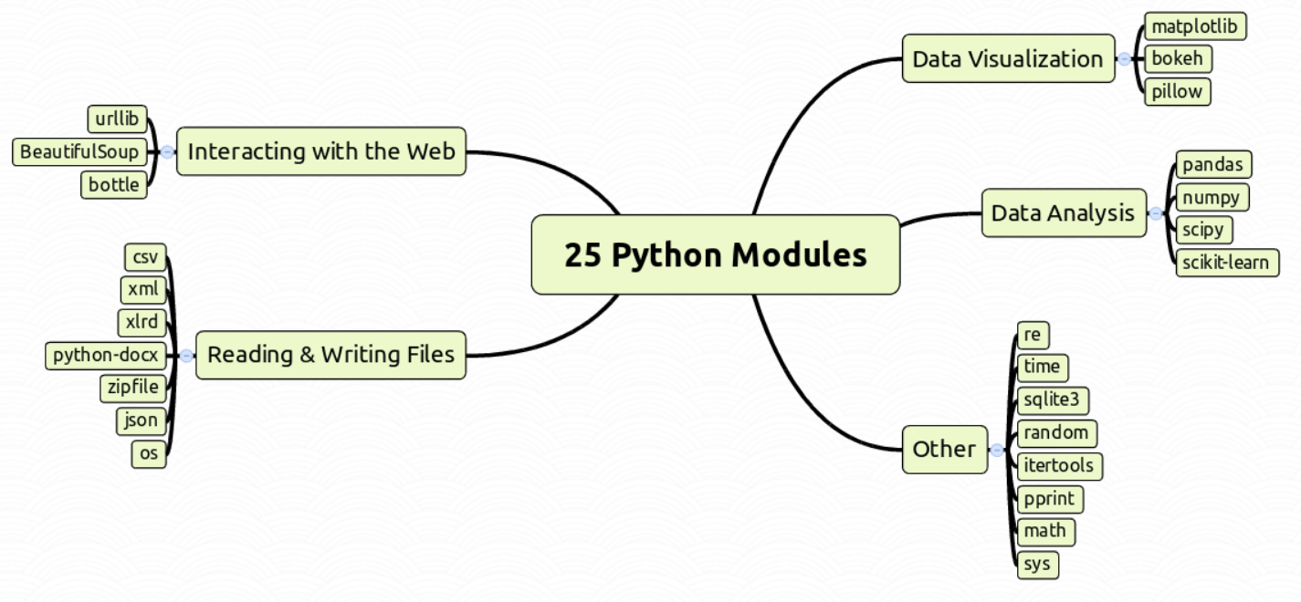
Introduction
A module is a file containing a set of functions you want to include in your application → packages program code and data for reuse → code library
Notes:
Figure by Kristian Rother (https://github.com/krother)

Slide 6
os
tempfile
humanfriendly
sys
fnmatch
math
glob
random
Other
Files (r+w)
shutil
time
filecmp
re
difflib
itertools
csv
>30 Python Modules
operator
openpyxl
pprint
docx
argparse
pdfrw
Databases
pandas
numpy
urllib
biopython
bs4
Web interactions
sqlite3
matplotlib
mysqlclient
Data science
selenium
bokeh
plotly
eutils
MySQLdb
scikit-learn
scikit-image
pillow

Slide 7
Functions

Slide 8
Functions
Functions maximize code reuse → split complex systems into manageable parts → if it must be changed later only one copy to update
Two ways to make functions: def and lambda
Two ways to send results back: return and yield
Two ways to manage scope visibility: global and nonlocal

Slide 9
Functions
Two ways to make functions: def and lambda
def is executable code → function does not exist until Python reaches and runs it → typically coded in module files which are imported first in your script
lambda creates an object but returns it as a result → creating function with lambda expression allows use of in-line function definition (where def statement won’t work syntactically)

Slide 10
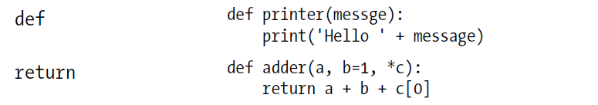
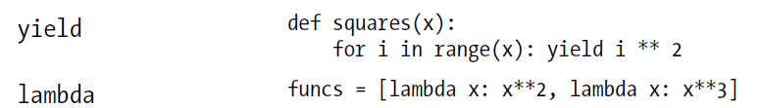
Functions
Two ways to make functions: def and lambda
Two ways to send results back: return and yield

Slide 11
Functions
Two ways to send results back: return and yield
return sends a result object back to the caller → functions that compute a value send it back → a return without value simply sends back None as default result
yield sends a result object back to the caller but remembers where it left off → functions known as generators may use yield to send back a value, suspend their state and resume later → to produce series of results over time (advanced)

Slide 12
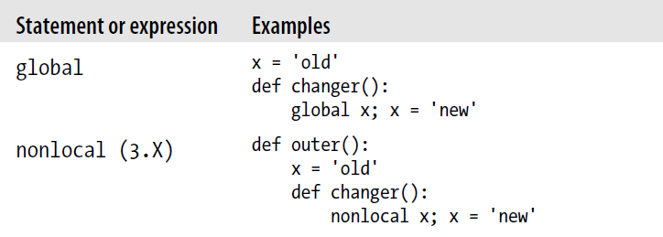
Functions
Two ways to manage scope visibility: global and nonlocal
global declares module-level variables that are to be assigned → default names assigned in function are local, only exist while function runs

Slide 13
Functions
nonlocal added in Python 3.X → declares enclosing function variables that are to be assigned → exists in scope of enclosing def statement → remember between function calls without shared global names

Slide 14
Functions
def consists of a header line followed by block of statements usually indented (or simple statement after colon) → statement block becomes function’s body
def header line specifies function name along with list of zero or more arguments (also called parameters) in parentheses

Slide 15
Functions
Arguments are passed by position → match argument names unless you say otherwise → pass by name with name=value keyword syntax
Arguments, return values and variables must not be declared
example-code-4-1.py
# Function definition
def times(x, y):
return x * y
# Function call
times(2, 4)

Slide 16
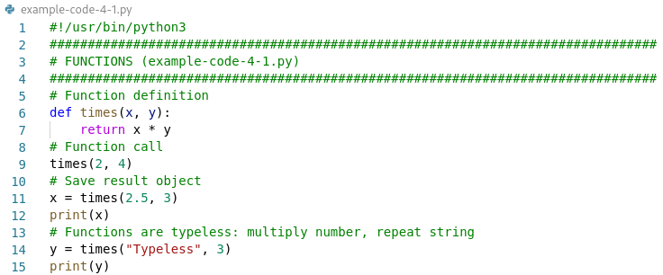
Functions

Slide 17
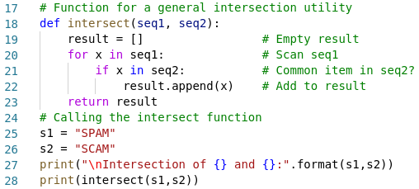
Functions

Slide 18
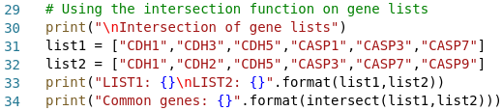
Functions

Slide 19
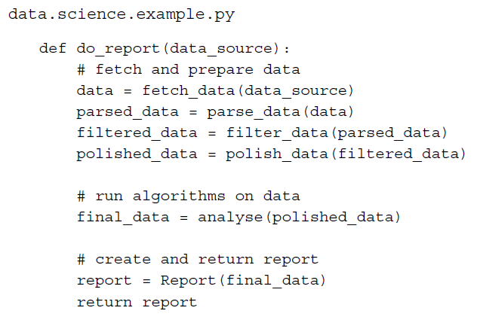
Functions
Following fictitious example: → easy to go through code → easy to debug

Slide 20
Modules

Slide 21
Modules
To create a module save the code in a file with the extension .py
Use the module by using the import statement
mymodule.py
example-code-4-2.py
#!/usr/bin/python3
# Save this code in mymodule.py
def greeting(name):
print("#"*80)
print("Hello {}".format(name))
print("#"*80)
# Import greeting from mymodule
import mymodule
mymodule.greeting("Paco")

Slide 22
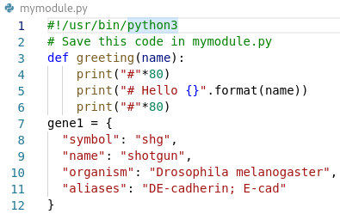
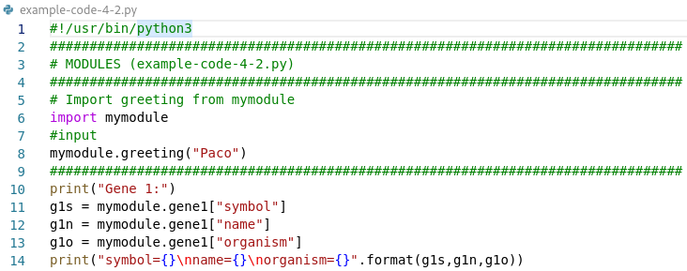

Slide 23
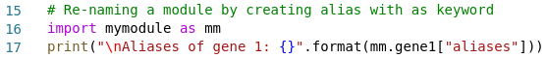
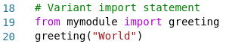
Modules
An imported module can be renamed by creating an alias with the as keyword
Variant of import statement imports names from module directly into symbol table → does not introduce module name → use function directly

Slide 24
Module time
Python has a module named time to handle time-related tasks
Unix system: January 1, 1970, 00:00:00 at UTC is epoch (point where time begins) → UTC = coordinated universal time cf. GMT = Greenwich Mean Time
Some commonly used time functions:
Function | Purpose
time.time() | Returns number of seconds passed since epoch
time.localtime() | Takes seconds passed epoch and returns struct_time in local time
time.strftime() | Takes struct_time and returns string representing it based on format code
time.sleep() | Suspends/delays execution of current action for given number of seconds

Slide 25
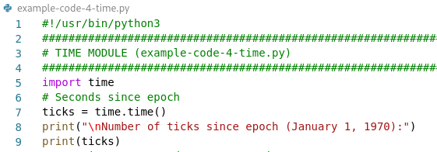
Module time
Dates before epoch cannot be represented in this form
Dates in far future also cannot be represented this way → cutoff point is sometime in 2038

Slide 26
Module time
Many of Python's time functions handle time as a tuple of 9 numbers
Index | Field | Values
0 | 4-digit year | 2019
1 | Month | 1 to 12
2 | Day | 1 to 31
3 | Hour | 0 to 23
4 | Minute | 0 to 59
5 | Second | 0 to 61
6 | Day of week | 0 to 6 (0 is Monday)
7 | Day of year | 1 to 366
8 | Daylight savings | -1, 0, 1 (-1 = library determines DST)

Slide 27
Module time
Tuple of 9 numbers → equivalent to struct_time structure
Index | Field | Attributes | Values
0 | 4-digit year | tm_year | 2019
1 | Month | tm_mon | 1 to 12
2 | Day | tm_mday | 1 to 31
3 | Hour | tm_hour | 0 to 23
4 | Minute | tm_min | 0 to 59
5 | Second | tm_sec | 0 to 61
6 | Day of week | tm_wday | 0 to 6 (0 is Monday)
7 | Day of year | tm_yday | 1 to 366
8 | Daylight savings | tm_isdst | -1, 0, 1 (-1 = library determines DST)

Slide 28
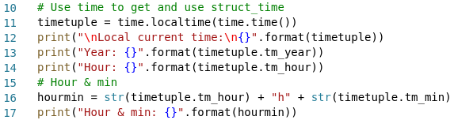
Module time
time.localtime() takes number of seconds passed since epoch time.time() as argument and returns struct_time tuple in local time

Slide 29
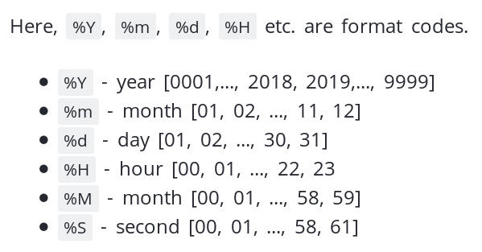
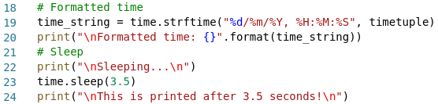
Module time
Use time.strftime() with your own format code to get preferred time string
example-code-4-2.py

Slide 30
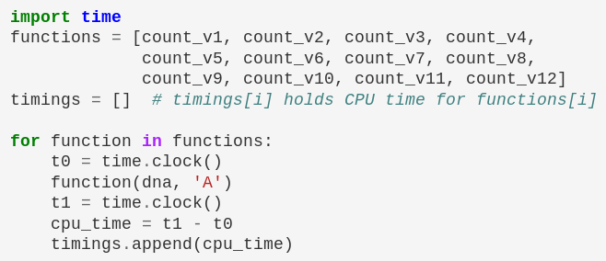
Module time
The time module can also be used to measure CPU time → to know time spent in a script
# import time module
t0 = time.clock()
# run statements
t1 = time.clock()
cpu_time = t1 – t0

Slide 31
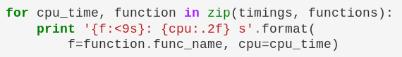
zip function
Built-in zip() function gives an iterator of tuples → takes iterables as arguments: can be list, string, dict (or user defined objects)
# zip function syntax
zip(*iterables)

Slide 32
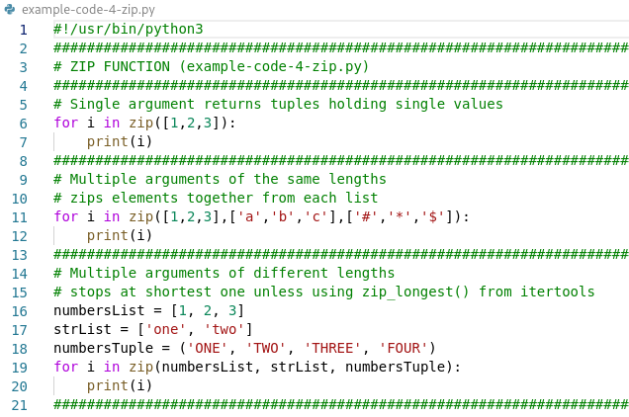
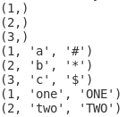
zip function
Examples of zip:
output

Slide 33
Module random
The random module provides access to functions that support many operations → allows to generate random numbers (can be in given range) → pick a random element from a list → other possible usage: password generator, random page, cards, coin flip

Slide 34
Module random
Some commonly used random functions:
Function | Purpose
random.random() | Return the next random floating point number in the range 0.0 to 1.0
random.randint() | Selects a random integer (two parameters, lowest & highest number)
random.choice() | Selects a random value from a sequence
random.shuffle() | Shuffles the elements in list in random order

Slide 35
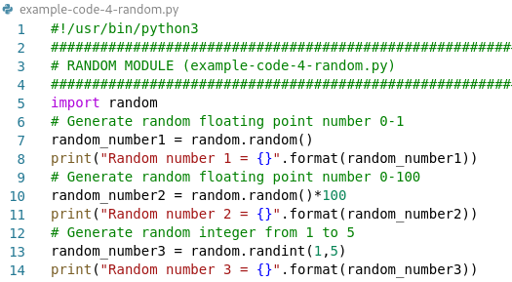
Module random

Slide 36
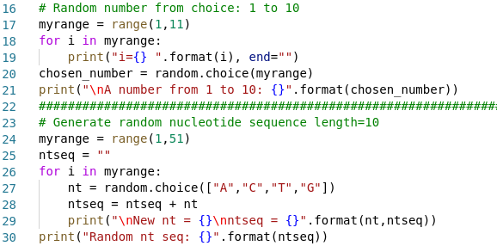
Module random

Slide 37
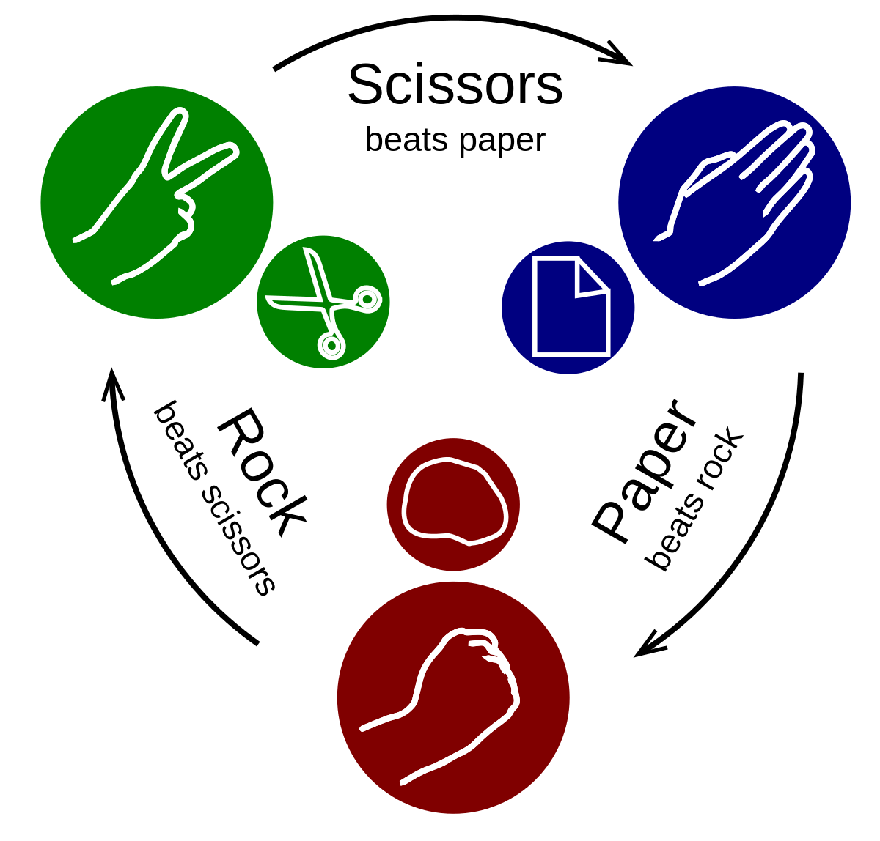
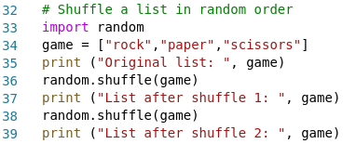
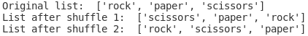
Module random
output

Slide 38
Module regular expressions
The re module implements regular expressions → syntax for pattern searching → installed by default
Method | Purpose
re.compile() | Compiles a RE into a pattern object which has methods
re.findall() | Find all substrings where the RE matches, and returns them as a list
re.finditer() | Find all substrings where the RE matches, and returns them as an iterator
re.sub() | Used to replace substrings
re.match() | Determine if the RE matches at the beginning of the string
re.search() | Scan through a string, looking for any location where this RE matches

Slide 39
Module regular expressions
Basic pattern | Match
a, A, 9 | Ordinary characters → just match themselvers exactly
. | A period → matches any single character except newline
* | Matches 0 or more repetitions
? | Matches 0 or 1 character of whatever precedes it
\w | Word character → matches letter or digit or underscore [a-ZA-Z0-9_]
\w+ | Matches one or more words/characters
\s | Matches a single whitespace character, space, newline, return, tab
\S | Matches any non-whitespace character
\d | Matches a decimal digit [0-9]
\D | Matches anything but a digit

Slide 40
Module regular expressions
Basic pattern | Match
^ | Match the start of the string
$ | Match the end of the string
d{1,5} | Matches a digit between 1 and 5 in lengths
{n} d{5} | Matches for n in a row e.g. 5 digits in a row
[abc] [a-z] | For specifying a character class → set of characters you wish to match → Can be listed individually [abc] or as range [a-z]
. ^ $ * + ? { [ ] | ( ) → meta-characters with special meaning
If you are unsure if a character has special meaning such as ‘@’ → put a slash in front of it (“\@”) to make sure it is treated just as a character

Slide 41
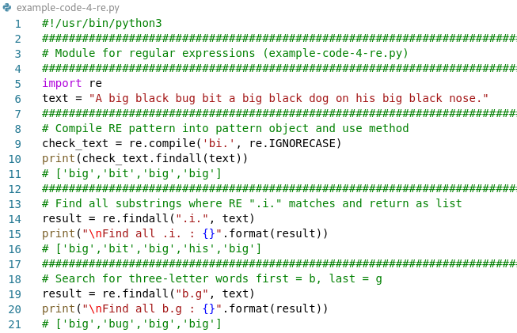
Module regular expressions

Slide 42
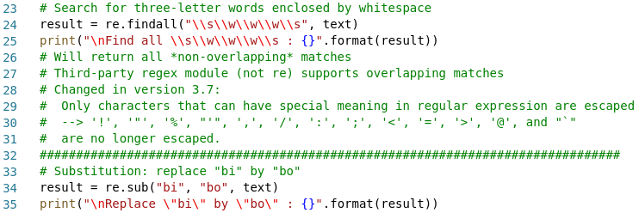
Module regular expressions
output

Slide 43
Module itertools
The itertools module implements a number of iterator building blocks for fast, memory efficient looping → form an “iterator algebra” → functions in itertools operate on iterators to produce more complex iterators
Three types of iterators:
Infinite iterators
Terminating iterators
Combinatoric iterators

Slide 44
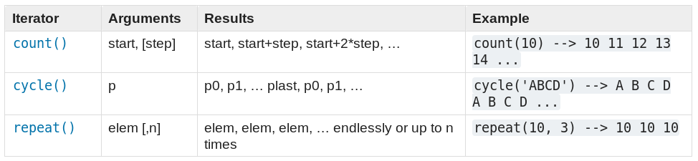
Module itertools
Infinite iterators
Useful for generating numbers or cycling over iterables of unknown length
Need to break out of iterator or will be infinite loop

Slide 45
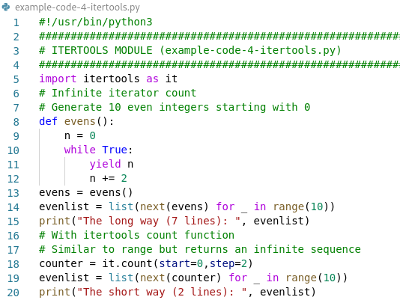
Module itertools

Slide 46
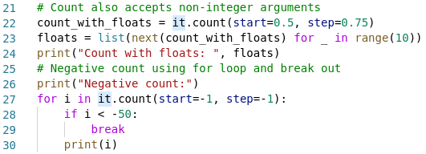
Module itertools

Slide 47
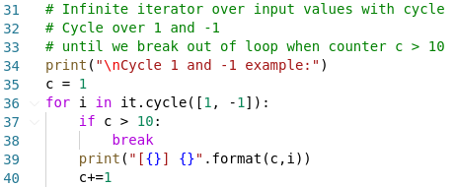
Module itertools

Slide 48
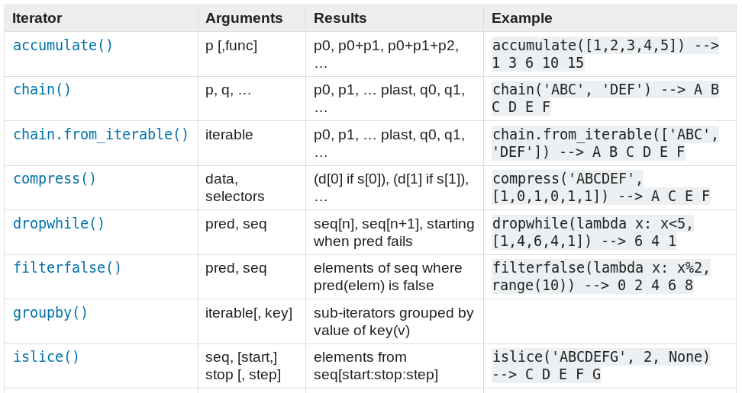
Module itertools
Terminating iterators

Slide 49
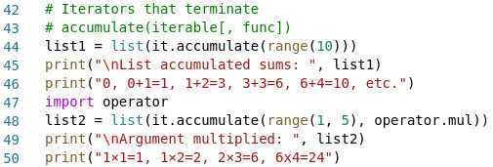
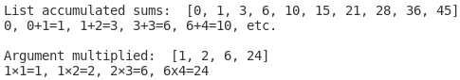
Module itertools
accumulate() function → can make iterator that returns accumulated sums or accumulated results
output

Slide 50
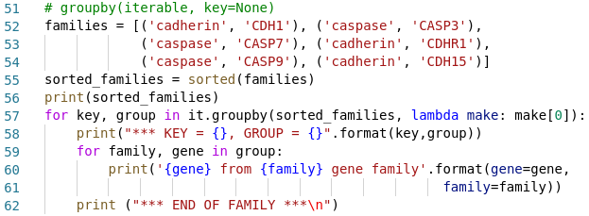
Module itertools
groupby() function → can make iterator that returns consecutive keys and groups from iterable → generates break or new group every time value of key changes

Slide 51
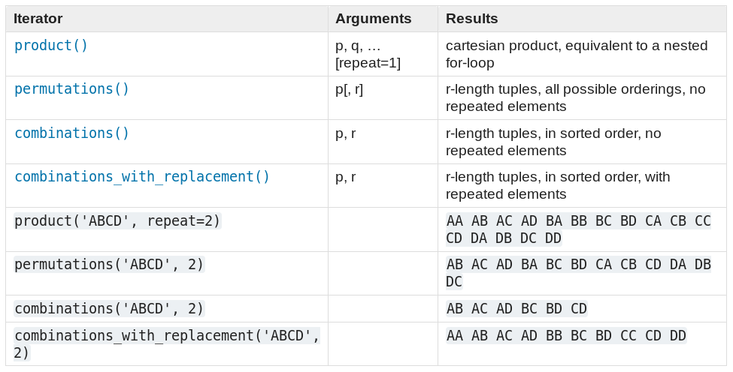
Module itertools
Combinatoric iterators

Slide 52
Module itertools
Brute-force or exhaustive search → problem-solving technique → enumerate all possible candidate solutions → check whether candidate satisfies problem’s statement → combinations!
Example: You have three € 20 banknotes, five € 10 banknotes and four € 5 banknotes. How many ways can you make change for € 100?

Slide 53
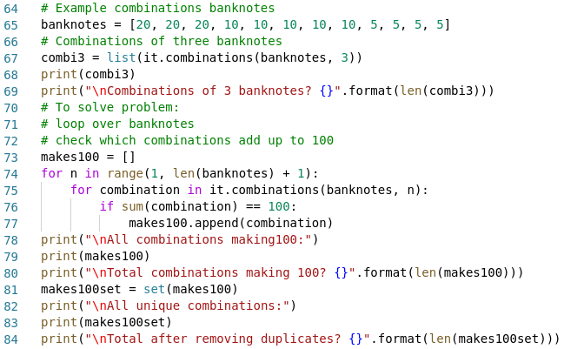
Module itertools

Slide 54
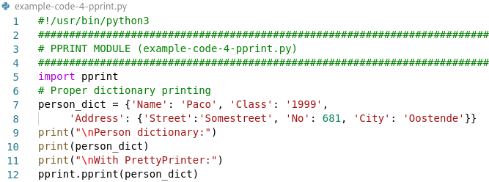
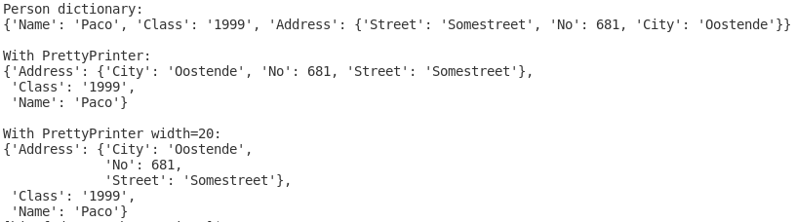
Module pprint
The pprint module is used for given proper printing formats to various data objects e.g. dictionary data or data objects containing JSON data

Slide 55
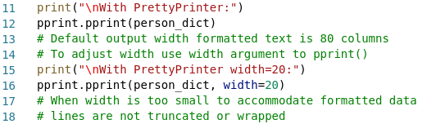

Slide 56
Module argparse
Recommended command-line parsing module in Python → what you use to get command line arguments into your script
argparse makes it easy to write user-friendly command-line interfaces → define what arguments are requires → argparse will figure out how to parse those out of sys.argv
import argparse
parser = argparse.ArgumentParser(description='Plot data')
parser.add_argument('indir', type=str, help='Input dir with data')
parser.add_argument('outdir', type=str, help='Output dir for images')
args = parser.parse_args()
print(args.indir)
python3 videos.py /videos /images

Slide 57
Module argparse
Recommended command-line parsing module in Python → what you use to get command line arguments into your script
argparse makes it easy to write user-friendly command-line interfaces → define what arguments are requires → argparse will figure out how to parse those out of sys.argv
getopt → other module with same task
import argparse
parser = argparse.ArgumentParser(description='Plot data')
parser.add_argument('indir', type=str, help='Input dir with data')
python videos.py /videos /images

Slide 58
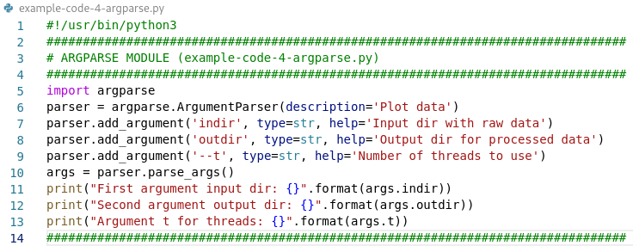
Module argparse

Slide 59
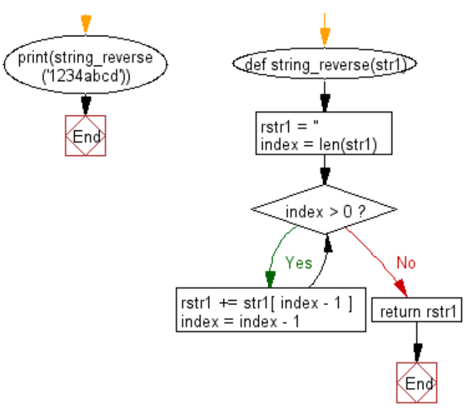
Exercise 4.1
Write a function to reverse a string
Following flowchart might help you →

Slide 60
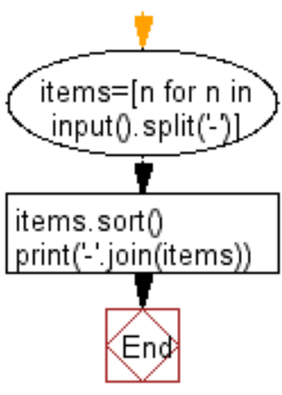
Exercise 4.2
Write a function that separates a string by a given character, sort the words and join them again by the separator
Type a character to separate a sequence of words:
$
Type a character separated sequence of words to sort and join again:
Sam$Gimli$Gandalf
Result:
Gandalf$Gimli$Sam

Slide 61
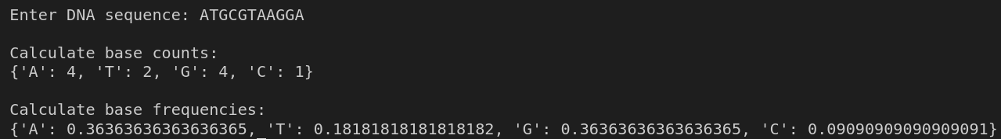
Exercise 4.3
Write a function to get base counts in a DNA sequence.
Use the first function to compute the base frequencies in a second function.

Slide 62
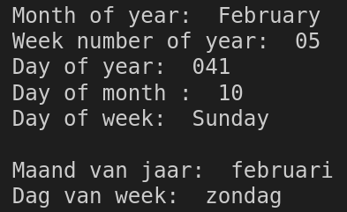
Exercise 4.4
Write a Python script to display the following date/time formats: a) Month of year
b) Week number of year
c) Day of year
d) Day of month
e) Day of week
f) Repeat month of year and day of week but in Dutch using locale module

Slide 63
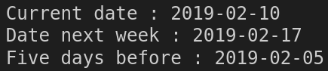
Exercise 4.5
Write a Python script using the datetime module to:
a) Print date next week
b) Print date five days before current date

Slide 64
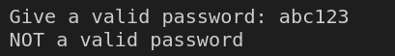
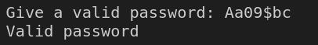
Exercise 4.6
Write a Python script to check the validity of password input by users Validation :
At least 1 letter between [a-z] and 1 letter between [A-Z].
At least 1 number between [0-9].
At least 1 character from [$#@].
Minimum length 6 characters.
Maximum length 16 characters.
Tip: use the re (regular expressions) module in combination with while and if

Slide 65


Exercise 4.7
Write a Python script to shuffle a deck of cards
Combine “ranks” and “suits” to generate the 52 cards
Use itertools & random to shuffle the cards twice and print each decks of cards

